Slide 1
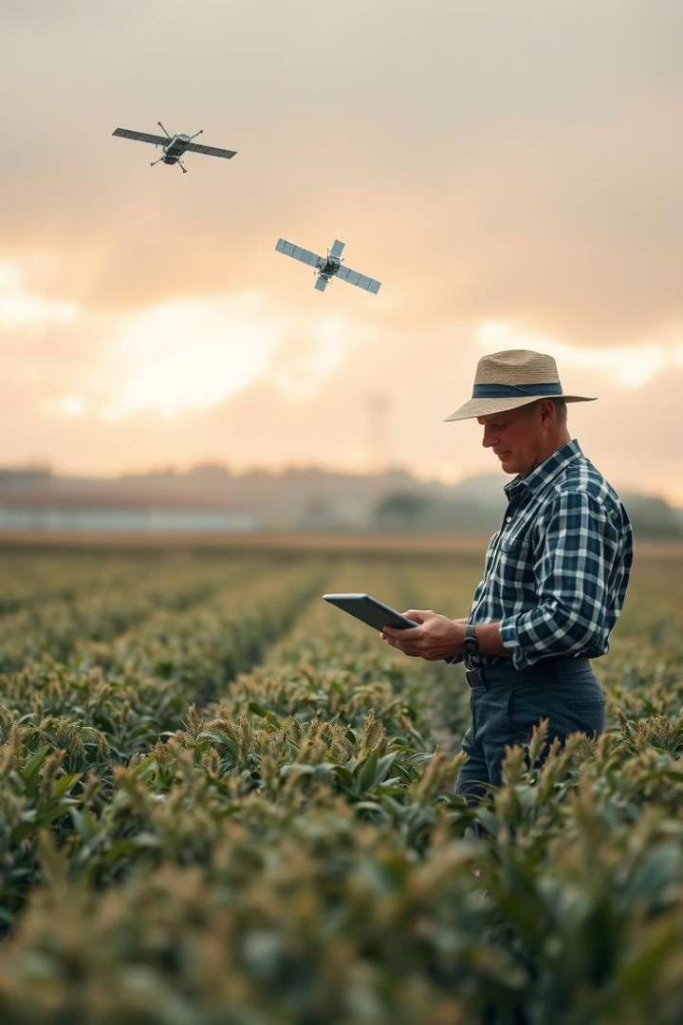
Satellite Rainfall Data for Agriculture: Empowering Farmers with Predictive Insights
Our project aims to revolutionize agricultural decision-making through satellite-based rainfall prediction. We've developed a tool that combines real-time satellite data with machine learning to provide accurate, timely weather forecasts for farmers and water managers.
Team: NeuralNexus
Members:
Aditya Jadhav
Vinit Hudiya
Group Name: NeuralNexus

Slide 2
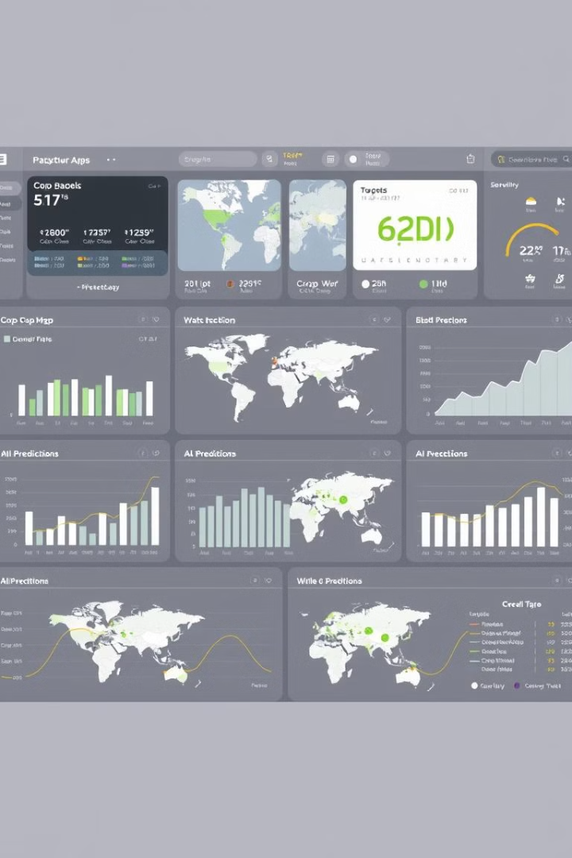
Project Overview: Bridging Data and Agriculture
1
Data-Driven Predictions
Implement machine learning models to forecast rainfall patterns with high accuracy.
2
Real-Time Updates
Integrate satellite data feeds to provide up-to-the-minute weather information.
3
Interactive Tools
Develop user-friendly interfaces with chatbots and visualizations for easy interpretation.
Group Name: NeuralNexus

Slide 3

Data Collection and Preparation: Building the Foundation
Kaggle Dataset
Utilized comprehensive daily weather data spanning 2008 to 2017 for model training.
Feature Selection
Extracted key parameters: temperature, humidity, wind speed, rain_today, month, and day.
Data Refinement
Created a streamlined dataset optimized for efficient model training and analysis.
Group Name: NeuralNexus

Slide 4

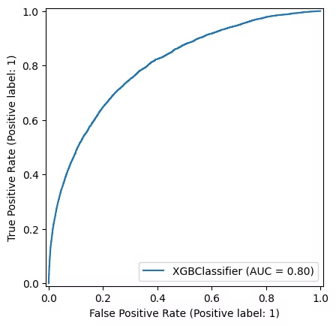
Model Training and Evaluation: Optimizing Predictions
XGBOOSTclassifier accuracy graph
To assess the performance of each algorithm, we evaluated their accuracy using key metrics. The accuracy results were then compared to identify the algorithm that consistently achieved the highest prediction accuracy. Accuracy, a metric that measures the percentage of correctly classified instances, is a key indicator of model performance. The results of our model evaluation are summarized in the table below.
Algorithm
Accuracy
CatBoostClassifier
68%
RandomForest
69%
Logistic Regression
71%
GaussianNB
69%
KNeighborsClassifier
66%
XGBoostClassifier
70%
Group Name: NeuralNexus

Slide 5
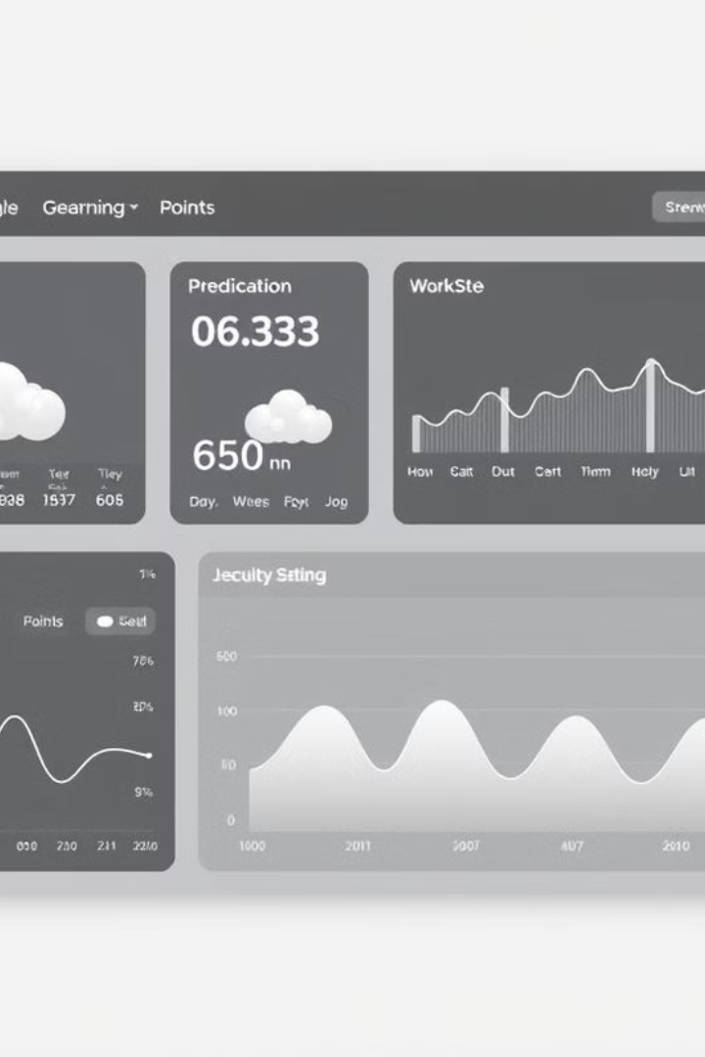
Web Application Development: User-Centric Design
1
Streamlit Framework
Leveraged Streamlit for rapid development of an intuitive, responsive web application.
2
Real-Time Integration
Implemented API connections to fetch and display current weather conditions.
3
Interactive Visualizations
Designed dynamic charts and graphs for clear data representation and analysis.
Group Name: NeuralNexus

Slide 6
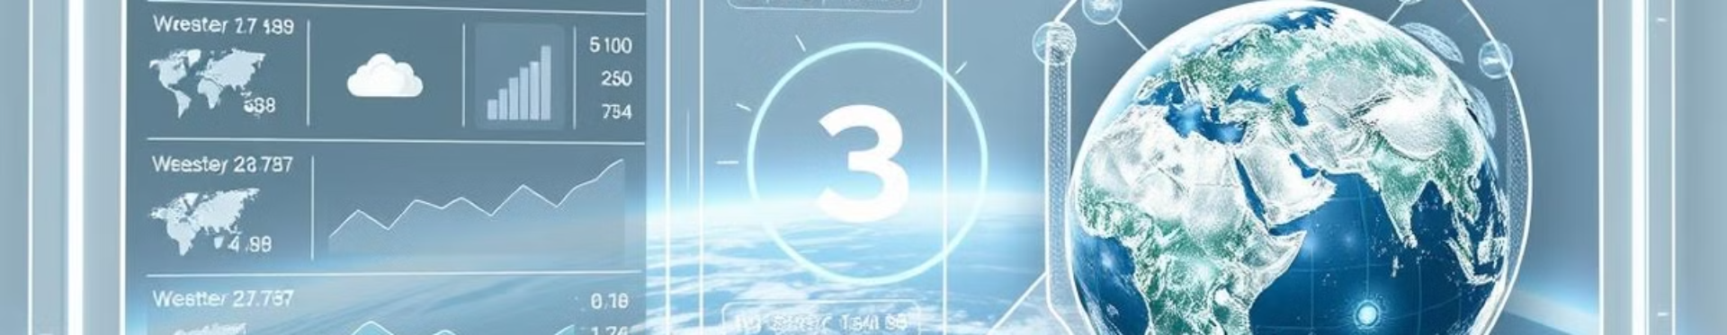



Key Application Components: Powering Intelligent Decisions
Open Meteo API
Gemini API Chatbot
XGBoost Prediction Model
Fetches real-time satellite data for up-to-date weather information and predictions.
Provides personalized weather advice and crop planning assistance to users.
Analyzes current conditions to forecast rainfall with high accuracy.
Group Name: NeuralNexus

Slide 7



Data Visualization and Additional Features: Enhancing Insights
Map Visualizations
Trend Analysis
User Empowerment
Interactive maps display regional weather data based on user-input coordinates. Users can explore patterns across different geographical areas.
Dynamic graphs showcase weather trends over time. This feature aids in long-term crop planning and resource allocation.
Comprehensive visuals enable farmers to make data-driven decisions. The tool transforms complex data into actionable insights.
Group Name: NeuralNexus

Slide 8




Conclusion and Future Directions
Current Achievement
Successfully developed a powerful tool for agricultural decision-making using satellite data.
Ongoing Improvements
Continuously refining prediction models and expanding data sources for enhanced accuracy.
Future Integration
Planning to incorporate IoT sensors and drone data for hyper-local predictions.
Group Name: NeuralNexus

